Slide 1
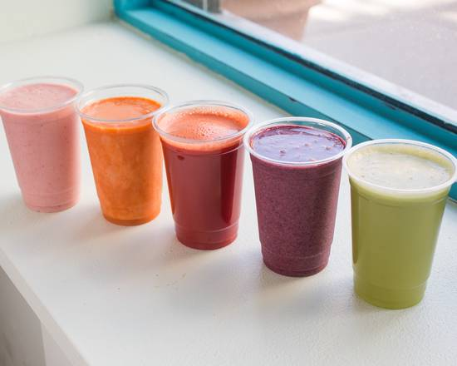
Randy’s Smoothie Shack™
Presented by: Preston Futaba, Steve Lee, Jacob Levinson, Randy Liu, Daniel Yang

Slide 2
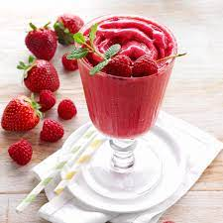
Overview
Love smoothies?
Have extra ingredients to use or a diet to follow?
MERN stack
MongoDB
Express JS
React
Node JS

Slide 3
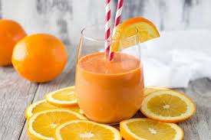
Requirements met:
Display dynamic data to user
All smoothies are stored in backend, and displayed based on user input on each page
Ability to upload data from client to backend
Add Smoothies
App can search through server side data
Smoothie Search
3 Special features
Notes:
Steve

Slide 4
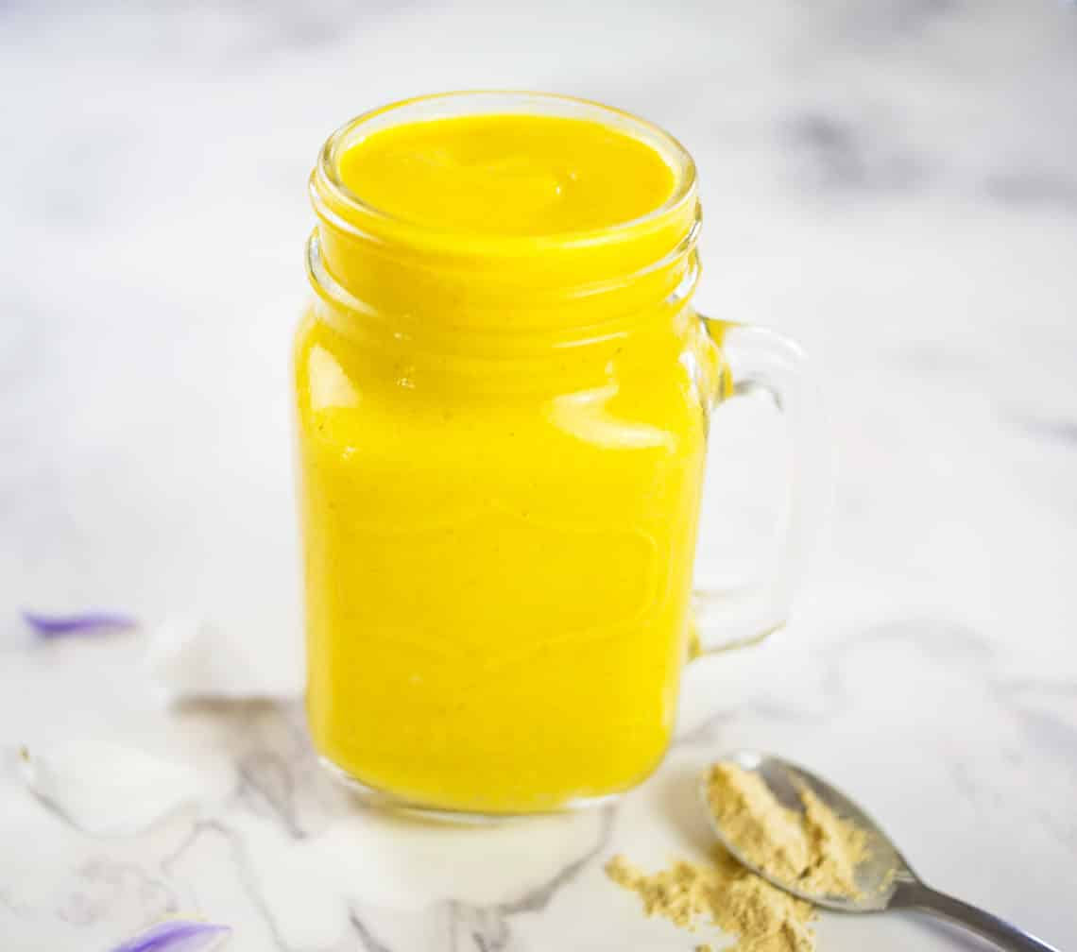
Special Features
3 Additional features:
Sort
Account Login and Signup
Favorites

Slide 5
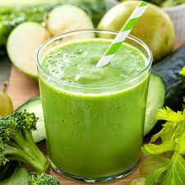
Sort
Dynamically sort based on user selection
Greatest to least and least to greatest
Notes:
Pfutaba: One of our special features is sorting smoothies. Upon choosing a field chosen in the dropdown button, the database array is sorted according to this field and is then returned. The sort feature displays a sorted array in the All Smoothies page in the navbar.

Slide 6
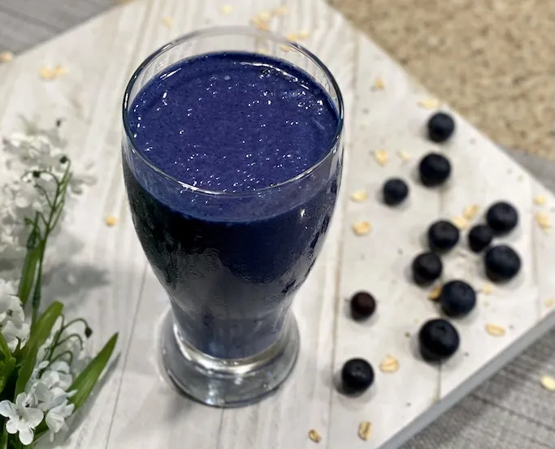
Accounts
Signup
Users are prevented from using a taken username
Users are prevented from submitting an empty name or password
Login
Username and Password are validated
Notes:
Jakeypoo

Slide 7
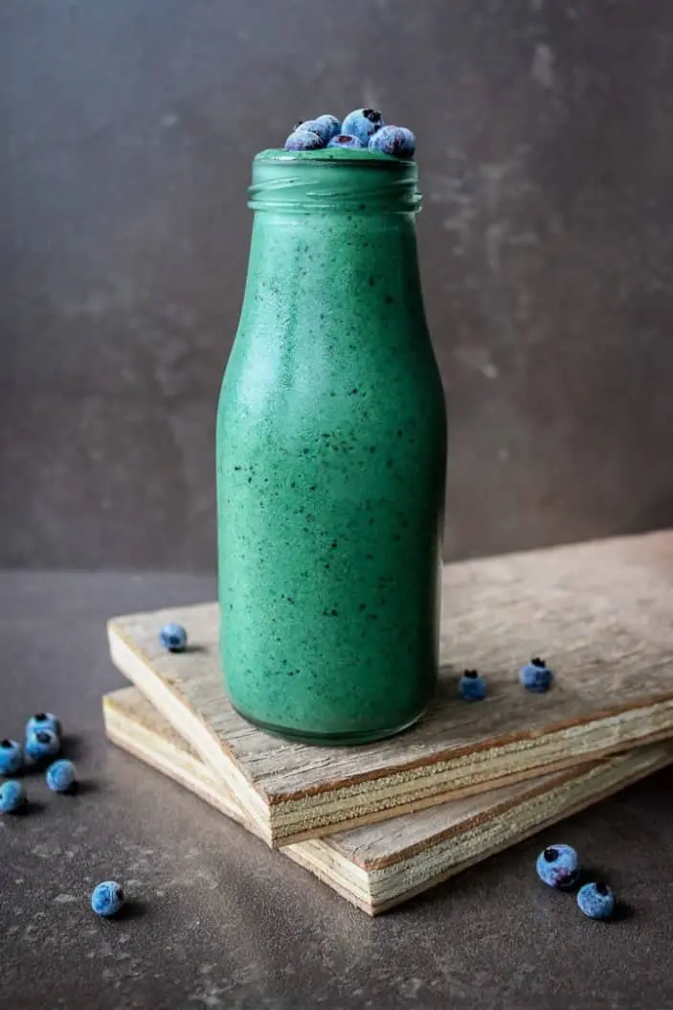
Favorites
Add Favorites
On homepage, buttons will appear next to smoothies
“Favorites” Tab
Page will only appear if logged in
List user’s favorite smoothies
Notes:
Danny

Slide 8
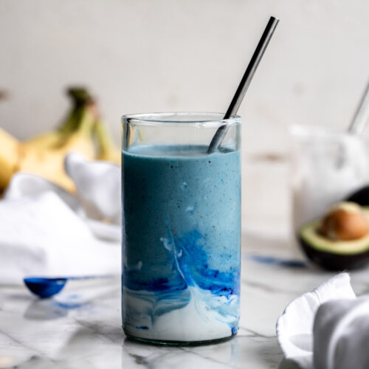
Trending Smoothies
Each time a smoothie is favorited by a user, it’s frequency is updated in the backend.
Then, we can sort by frequency to see the most trending smoothies.

Slide 9
Thanks for watching
and keep on Shackin’

